Slide 1
Webcam Fuzz Testing: Testing IoT Deployments
Matthew Elbert
Jeffrey Kitchen

Slide 2
Fuzz Testing (Fuzzing)
Sending a program random inputs
Can be automated
Cheaper to implement than other testing methods
Particularly useful for network-facing interfaces, as they could see any random command from the Internet.
Can reveal bugs and vulnerabilities

Slide 3
Why IP Cameras?
Some of the most commercially available Internet of Things (IoT) deployments
Support a number of network protocols, including HTTP servers
May not be as heavily tested as other network services
Not easily updated (perhaps more vulnerable)
If fuzzing could impair or disable the cameras, it poses interesting ramifications for security
No critical or disabling bugs found, but we did see some interesting results.

Slide 4
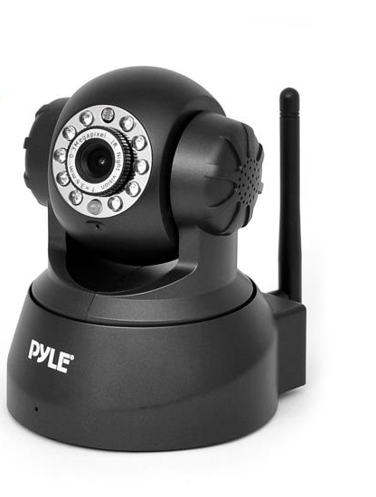
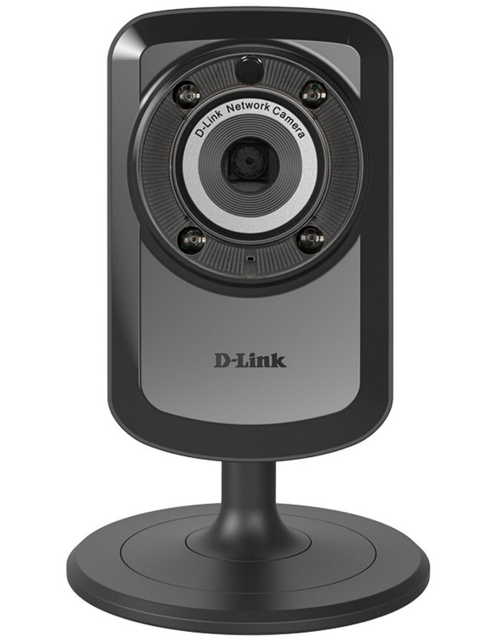
Devices Under Test
D-Link Wireless Day/Night WiFi Network Surveillance Camera
(DCS-934L)
Pyle PIPCAM5 IP Camera Surveillance Security Monitor

Slide 5
Device Under Test
Supported protocols →
IPv4, ARP, TCP, UDP, ICMP
DHCP Client
NTP Client (D-Link)
DNS Client
DDNS Client
SMTP Client
FTP Client
HTTP Server
PPPoE
UPnP port forwarding
RTP, RTSP, RTCP (D-Link)
LLTD (D-Link)
GPRS (Pyle)

Slide 6
Testing HTTP
ADVANTAGES
Widely deployed
Many solutions available
Easy to access
Well understood
Many vulnerabilities found
2. DISADVANTAGES
Widely deployed
Many implementations are hardened from the vulnerabilities found on them

Slide 7
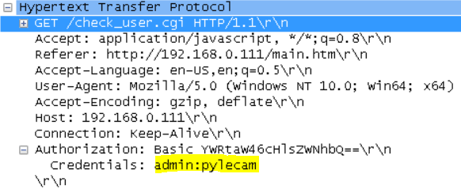
Information Gathering
Used Wireshark to capture valid traffic from cameras
Found authentication (username:password) in plain text!
Viewed the camera web page sources
Found .cgi pages, valid commands
Pyle Cam uses mainly HTTP GET with command codes
Dlink Cam uses mainly HTTP POST with command in packet body

Slide 8
Available Tools
The Peach Fuzzing Platform
http://www.peachfuzzer.com/
AutoFuzz
http://autofuzz.sourceforge.net/
American Fuzzy Lop
http://lcamtuf.coredump.cx/afl/
Pathod/Pathoc
http://pathod.net/index.html

Slide 9
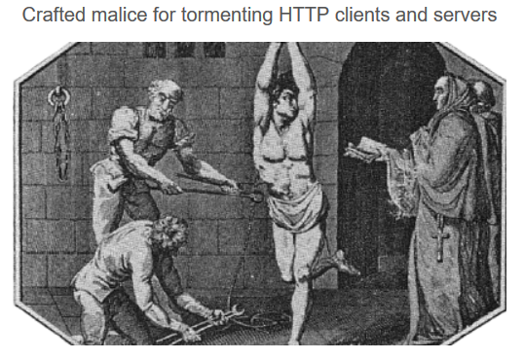
Tool Used: Pathoc http://pathod.net/
Pathod - A pathological web daemon.
Pathoc - A perverse HTTP client.

Slide 10
Pathoc Examples
Simple command line interface
pathoc hostname request [request ...]
pathoc localhost get:/:b@10:ir,@1
Using script variables
pathoc $ip 'get:@70000,ascii:b@100,ascii:h“....
pathoc $ip 'post:/nightmodecontrol.cgi:b"IRLed='$r'":ir,@5:h“..

Slide 11
Bash Script Framework
Script arguments
IP address, Camera ID, 1=PYLE, 2=DLINK, Number of tests
Bash variables
Random numbers,
Body and header strings
Authentication credentials
Loops to repeatedly call pathoc with different inputs.
Aggregate and count outputs in log files

Slide 12
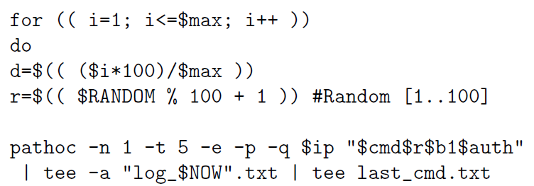
Code Snippit

Slide 13
Types of Fuzzing
Valid requests with random bytes inserted
Long GET requests (>70,000 byte)
Long headers (>70,000 byte)
POST with random commands
Long post body (>70,000 byte)
GET .cgi commands
Numbers (valid, invalid, large or negative)
Strings of random length

Slide 14
Number of Tests Run
Have run 270,700 tests over the course of a week
Very Time Consuming!
We saw averages around .75 - 2 seconds per test. Some tests (long requests, body or headers) timed out around 5 seconds.
Test runs of 30,000 tests could easily take 12 hours or more
Set our laptops to run overnight and on weekends.
Explored other test platforms (R PI was used for 24 hr. run)

Slide 15
Platforms
Oracle’s VM VirtualBox 5.0.10 (two separate Windows 10 laptops)
32-bit Ubuntu 12.04 VM with 2.0GiB of dedicated RAM
All-in-one SDN App Development Starter VM, 64-bit Ubuntu 14.04
Raspberry Pi 2 model B (RPi)
Raspbian, (Debian), kernel version 4.1.7.
USB 802.11nWiFi adapter
Fuzzing script and log files on 16GB USB flash drive.
Testing generally took longer on this platform.

Slide 16
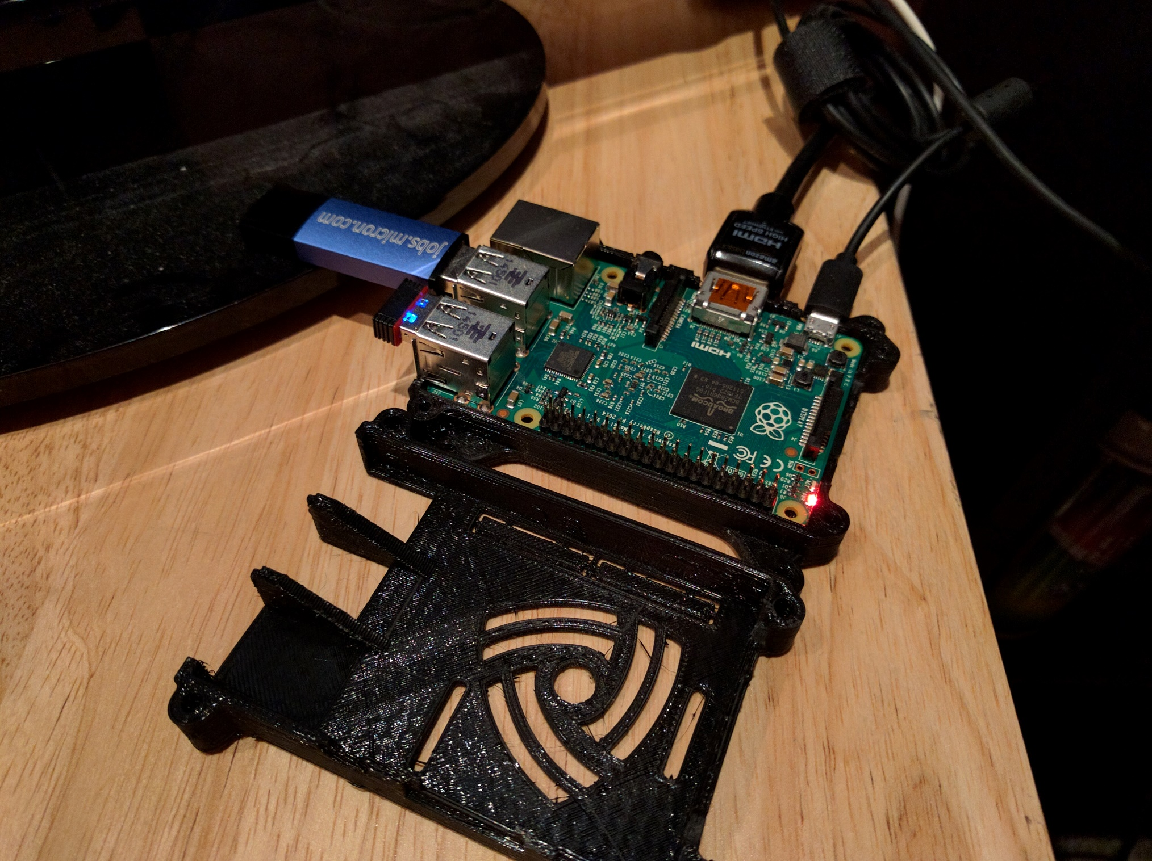

Slide 17
Distribution of Results
HTTP 200 Returns:71645
HTTP (non-200) 2XX Returns:14995
HTTP 400 Returns:10199
HTTP 401 Returns:72741
HTTP 404 Returns:20843
HTTP 500 Returns:2
HTTP 501 Returns:1124
Timeouts:7919
Invalid server response: Server disconnect:5223
Error connecting to <ipaddr>: [Errno 110] Connection timed out: Uncounted

Slide 18
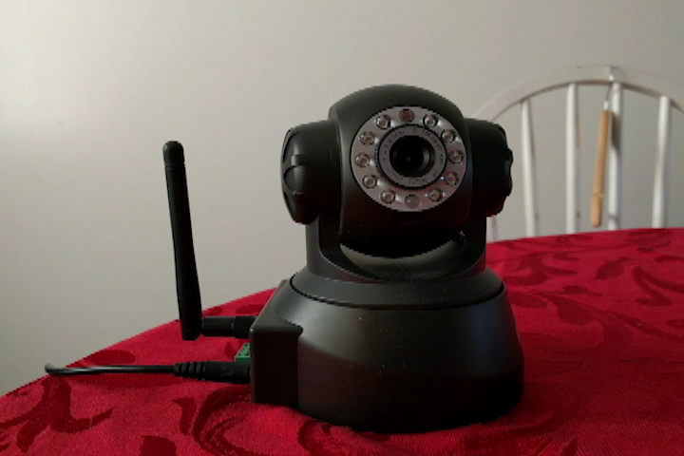

Slide 19
Future Work Ideas
Further analysis on root cause of server errors, connection timeouts, etc.
Test the numerous other protocols.
Recognize interesting outputs and repeat/mutate the corresponding inputs.
Use HTTP validator to verify outputs.
Record and evaluate video quality during fuzzing.

Slide 20
Related Work
BANKS, G., COVA, M., FELMETSGER, V., ALMEROTH, K.,
KEMMERER, R., AND VIGNA, G. Snooze: Toward a stateful
network protocol fuzzer. In of Lecture Notes in Computer Science
(2006), Springer, pp. 343–358.
T. KITAGAWA, M. H., AND KONO, K. Aspfuzz: A state-aware
protocol fuzzer based on application-layer protocols. In Computers
and Communications (ISCC), June 2010 IEEE Symposium,
pp. 202–208.
TSANKOV, P., DASHTI, M. T., AND BASIN, D. Secfuzz: Fuzztesting
security protocols. In Proceedings of the 7th International
Workshop on Automation of Software Test (Piscataway, NJ, USA,
2012), AST ’12, IEEE Press, pp. 1–7.

